Slide 1
Large Language Models

Slide 2
A GPT is a Generative Pre-Trained Transformer.
The first two words are self-explanatory: generative means the model generates new text; pre-trained means the model was trained on large amounts of data.

Slide 3
Transformer
A transformer is a special kind of neural network, a Machine Learning Model. There are a wide variety of models that can be built using transformers: voice-to-text, text-to-voice, text-to-image, machine translation, and many more.
The specific variant that we will focus on, which is the type that underlies tools like ChatGPT, will be a model trained to take in a piece of text, maybe even with some surrounding images or sound accompanying it, then produce a prediction of what comes next, in the form of a probability distribution over all chunks of text that might follow.

Slide 4
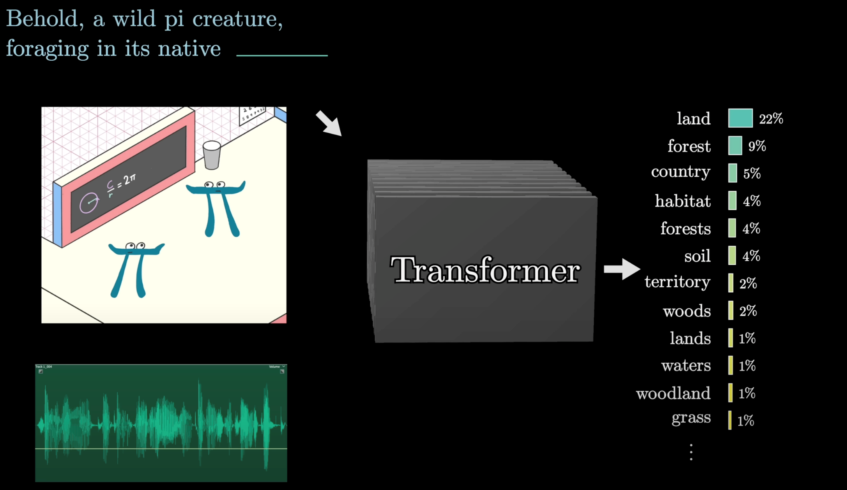

Slide 5
Tokens
An input is first broken into small chunks that are known as tokens.
Each of these tokens is then associated with a vector, meaning some list of numbers.
A common interpretation of these embeddings is that the coordinates of these vectors may somehow encode the meaning of each token.
If you think of these vectors as giving coordinates in some high-dimensional space, words with similar meanings tend to land on vectors close to each other in that space.
These steps are pre-processing steps that occur before anything enters the transformer itself.

Slide 6
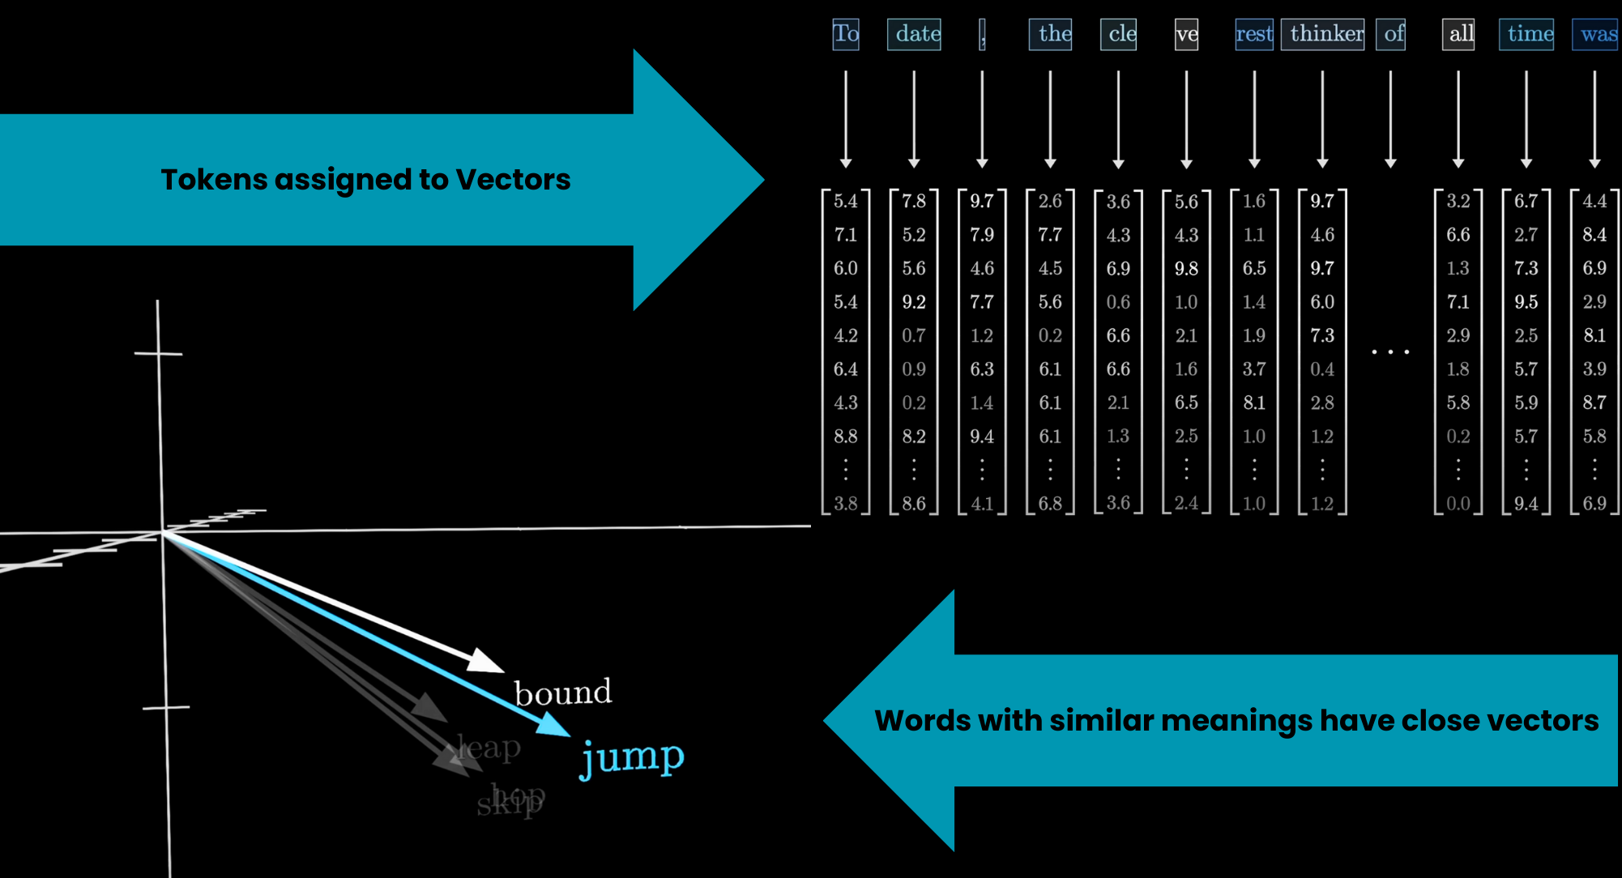

Slide 7
Attention Block
The encoded vectors then pass through an Attention Block where they communicate with each other to update their values based on context.
For example, the meaning of the word model in the phrase a machine learning model is different from its meaning in the phrase a fashion model.
The Attention Block is responsible for figuring out which words in the context are relevant to updating the meanings of other words and how exactly those meanings should be updated.

Slide 8
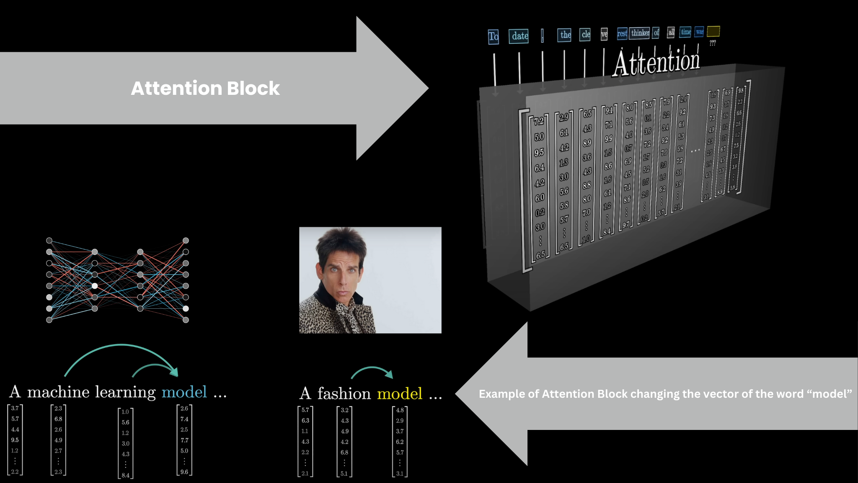

Slide 9
Multilayer Perceptron(Feed-Forward Layer)
Following the Attention Block, these vectors then pass through a Multilayer Perceptron, or Feed-Forward Layer.
Here, the vectors don’t talk to each other; they all go through the same operation in parallel.

Slide 10
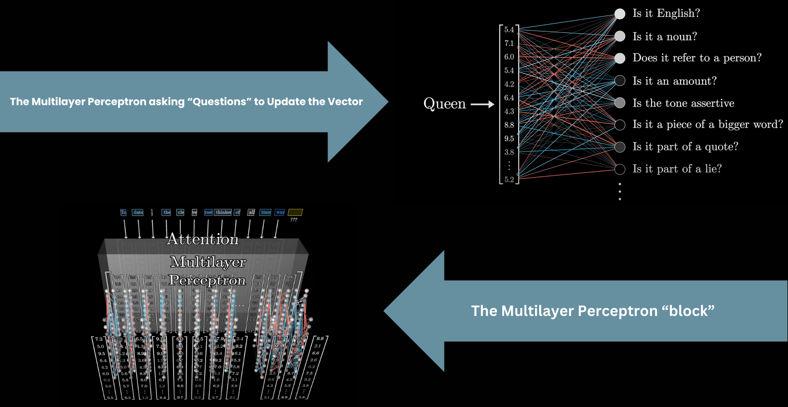

Slide 11
After that, the vectors pass through another attention block, then another multilayer perceptron block, then another attention block, and so on, getting altered by many variants of these two operations interlaced with one another.
After many iterations, all the information necessary to predict the next word needs to be encoded into the last vector of the sequence, which will go through one final computation to produce a probability distribution over all the possible chunks of text that might come next.

Slide 12
Deep Learning
The simplest form of machine learning might be linear regression, where inputs and outputs are single numbers, such as the square footage of a house and its price.
A linear regression finds the line of best fit through the data to predict future house prices.
This line is determined by two parameters: the slope and the y-intercept, which are tuned to most closely match the data.
Then for future houses, with unknown prices, the predicted price would be determined based on the value of this line over the given square footage.

Slide 13
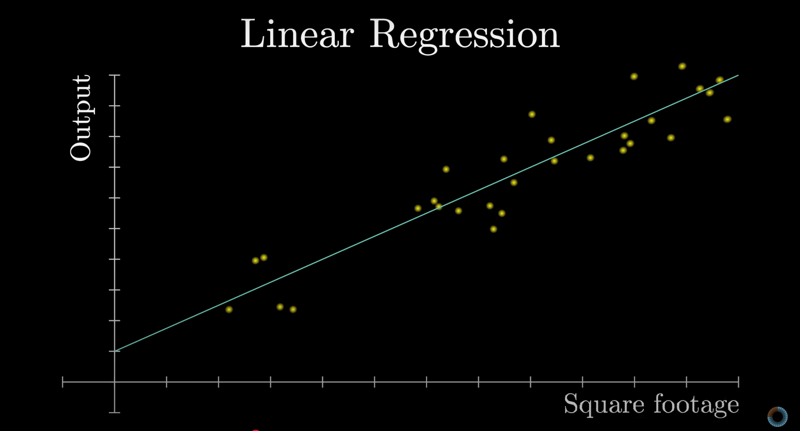

Slide 14
Deep learning is a subfield of Machine Learning, focused on a specific category of models known as Neural Networks.
First, the input to the model has to be formatted as an array of real numbers.
This could simply mean a list of numbers, a 2D array, or often higher-dimensional arrays, where the general term used here is tensor.
The input data is progressively transformed into many different layers, always structured like some array of numbers, until it reaches the final layer as the output.
For example, the final layer in our next-token-prediction model is the probability distribution over all possible next tokens.

Slide 15
What Are Weights?
Weights are the trainable parameters in deep learning models.
They determine how input data influences the output.
How Weights Interact with Data
Weights apply weighted sums to input features.
Each neuron’s output is a combination of inputs, multiplied by corresponding weights.
Weights Stored as Matrices
Instead of individual calculations, weights are packaged in matrices.
Matrix-vector multiplication simplifies the computation.

Slide 16
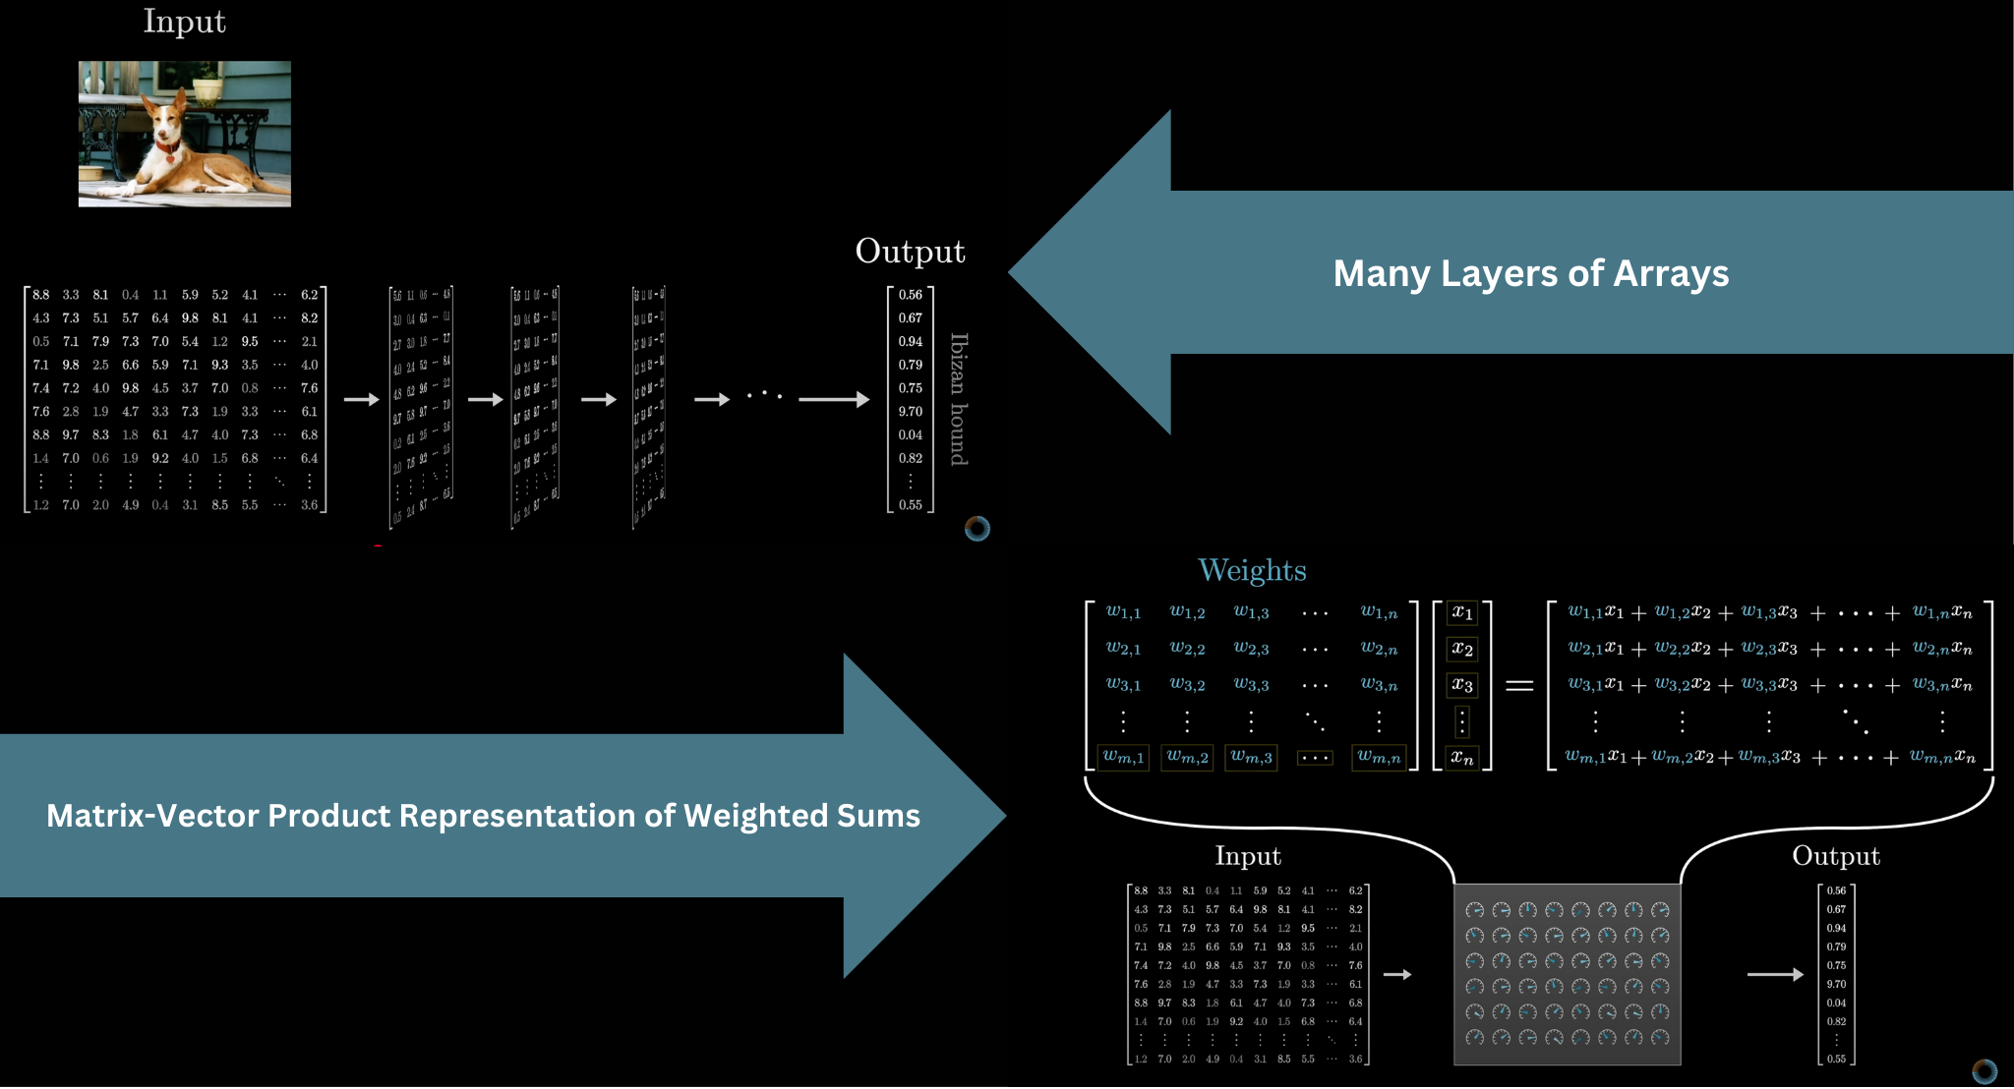

Slide 17
Embedding
sentence → tokens → vectors
one-hot, embeddings
In one-hot encoding, each word gets a vector like [0, 0, 1, 0, 0]
Each word is mapped to a dense vector like:
"King" → [0.27, 0.81, -0.55, ...]
"Queen" → [0.29, 0.79, -0.57, ...]
These vectors are learned from data using neural networks or algorithms like Word2Vec, GloVe, or during the training of models like GPT.
Similar words will have similar vectors.

Slide 18
Word | Embedding
King | [0.3, 0.8]
Queen | [0.31, 0.79]
Apple | [-0.5, 0.1]
Notice that "King" and "Queen" are closer in vector space than "King" and "Apple".

Slide 19
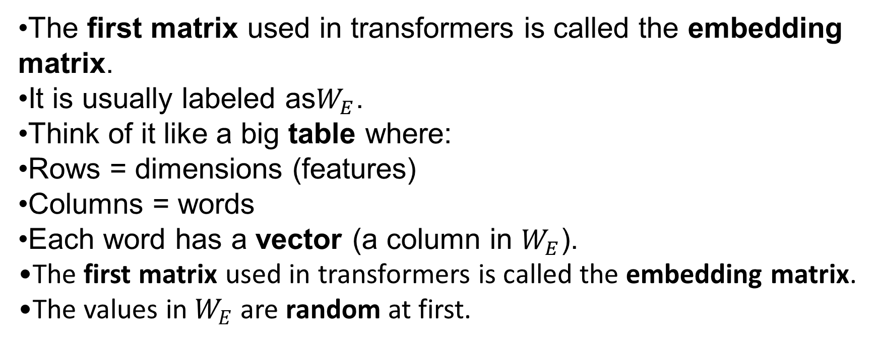
Embedding Matrix
The first matrix used in transformers is called the embedding matrix.
It is usually labeled as$W_{E}$​.
Think of it like a big table where:
Rows = dimensions (features)
Columns = words
Each word has a vector (a column in $W_{E}$​).
The first matrix used in transformers is called the embedding matrix.
The values in $W_{E}$​ are random at first.

Slide 20
But during training, the model learns these values.
Words that occur in similar contexts get similar vectors.
You can imagine vectors as points in space.
A simple example:
A 3-number vector looks like a point in 3D space.
In reality:
Models like GPT-3 use 12,288 dimensions.
More dimensions = more ways to separate and connect words.

Slide 21
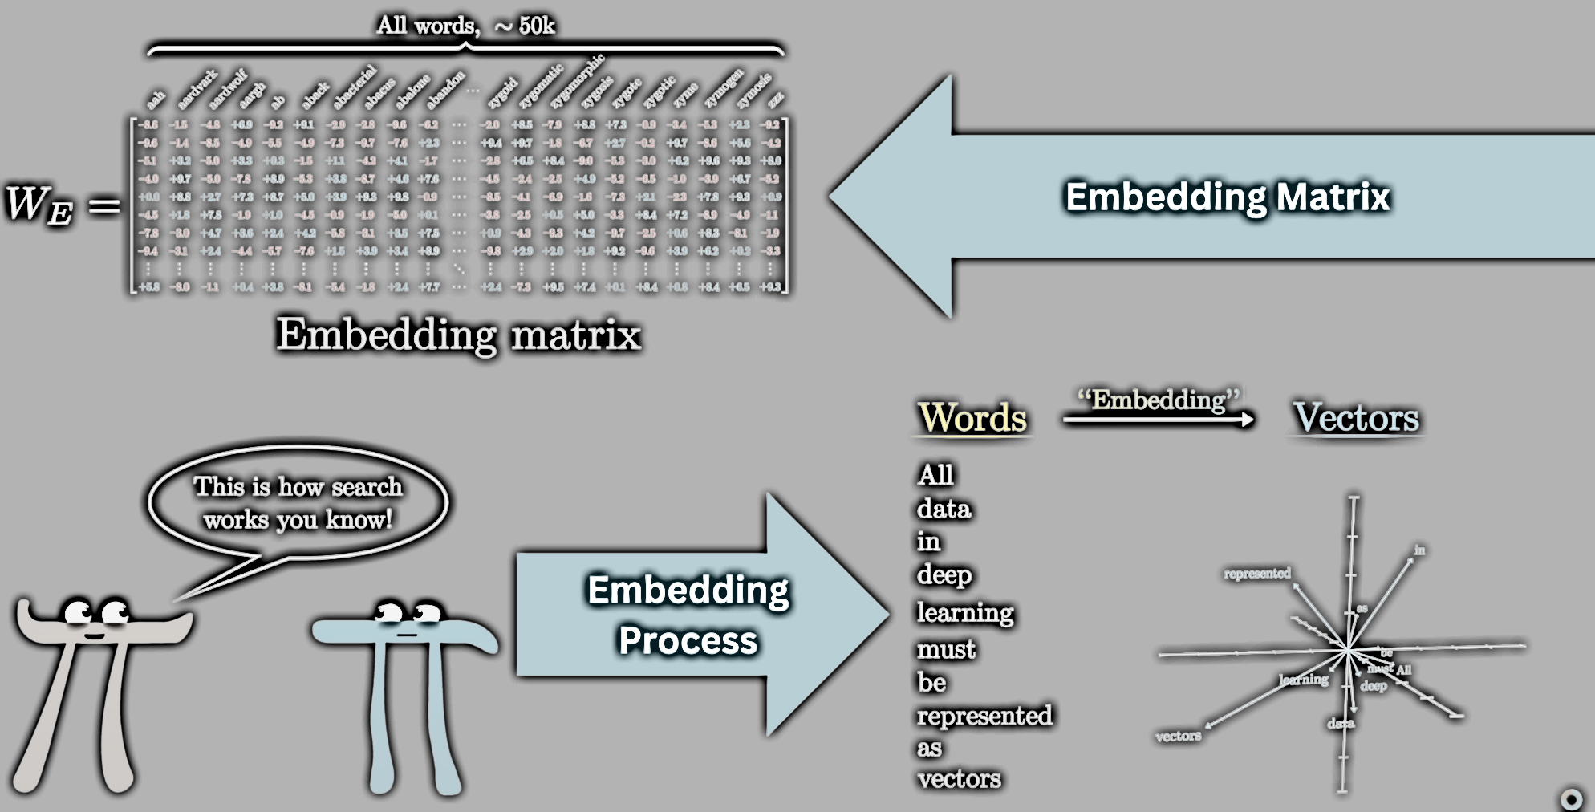

Slide 22
Direction
Similar words are close together.
Directions in space start to have meaning.
he model finds a structure where:
Groups of words form clusters.
Specific directions in space represent concepts like:
Size
Royalty
Location
Emotion

Slide 23
Imagine there is a direction in vector space where:
Moving forward means bigger.
Moving backward means smaller.
So if you take the vector for mouse and move in the "size" direction, you might reach cat, then tiger, then elephant.

Slide 24
Concept of Royalty
There might be a direction where:
Starting from man and moving in the "royalty" direction gives you king.
Starting from woman and moving in the same direction gives you queen.

Slide 25
Location
Similarly, there could be a direction that represents geography.
Moving along that direction might relate words like:
city, village, country, continent.

Slide 26
The Word "Tower“
Visual:Show a search for words similar to "tower".
The model returns:
castle
spire
fortress
skyscraper
All of them share the same vibe (buildings, tall structures).

Slide 27
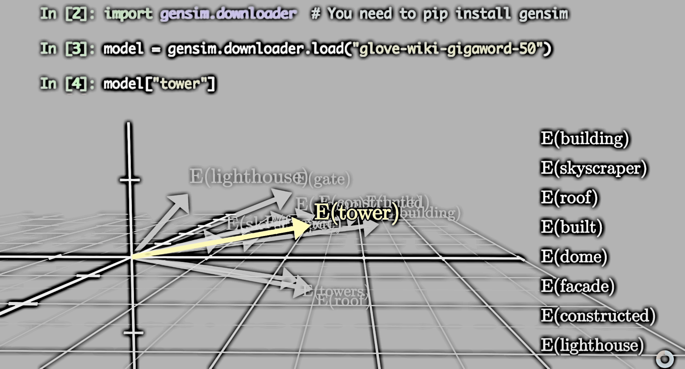

Slide 28
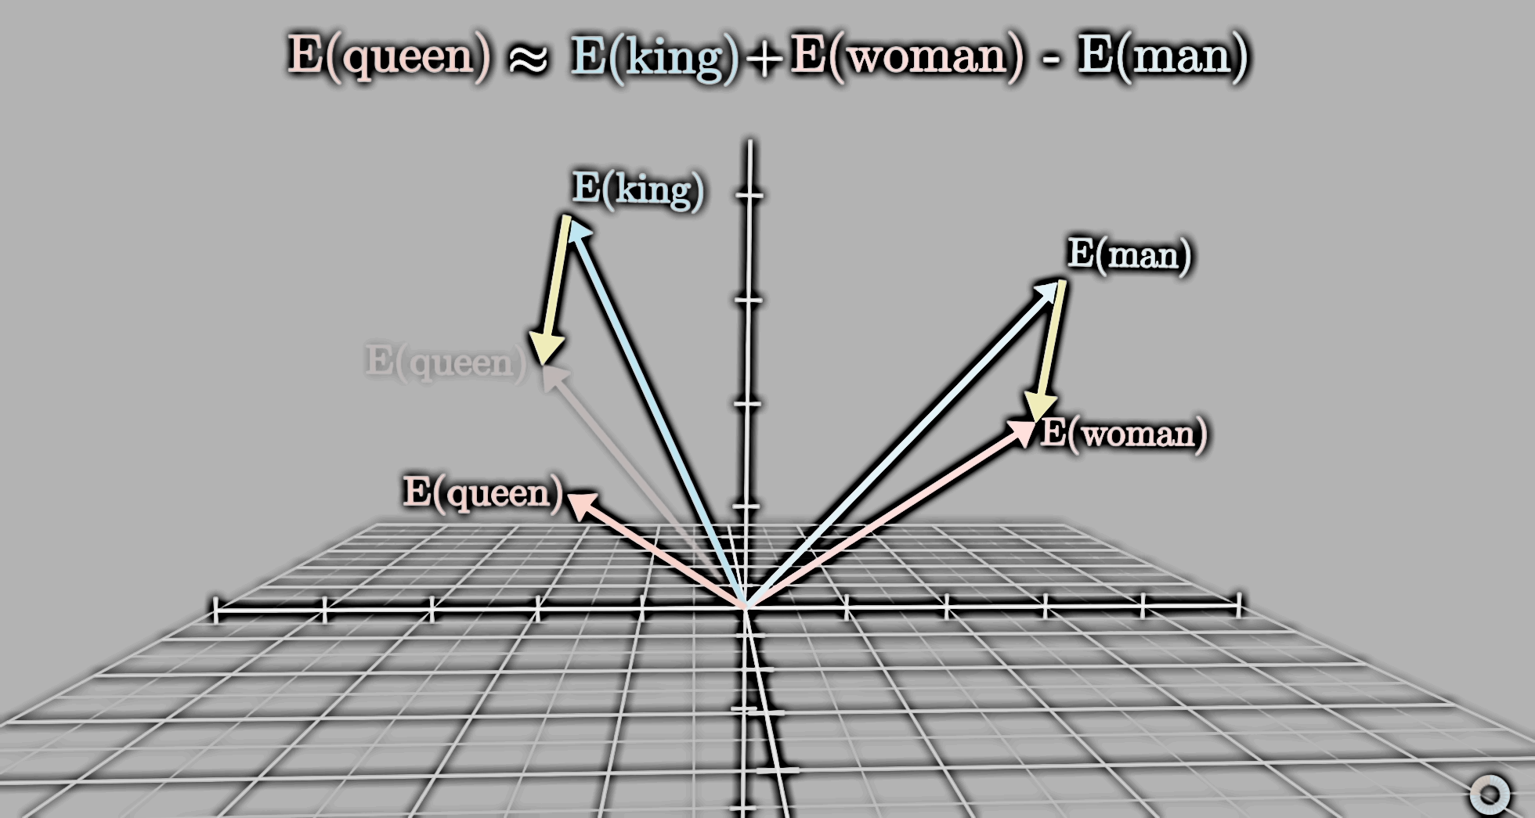

Slide 29
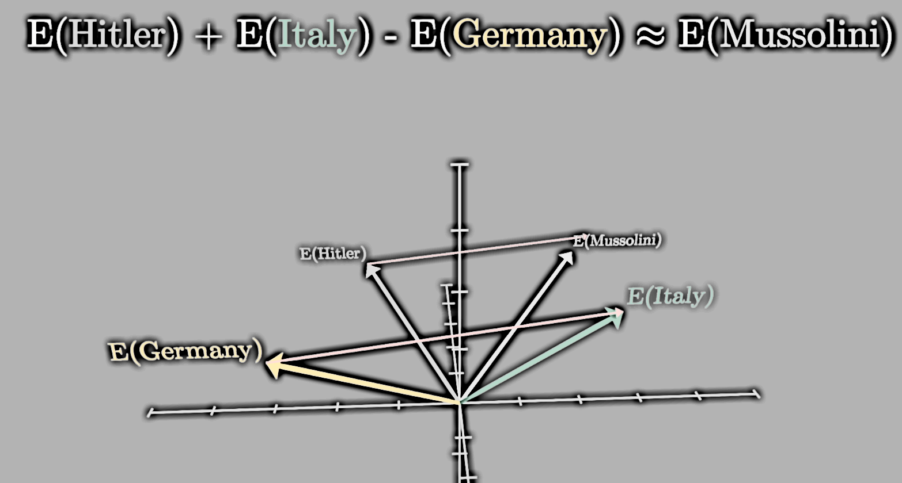

Slide 30
Dot Product
Computationally, dot products involve multiplying all aligning components and adding the result.
Geometrically, the dot product is positive when the vectors point in a similar direction
Zero if they're perpendicular
Negative when they point in opposite directions.

Slide 31
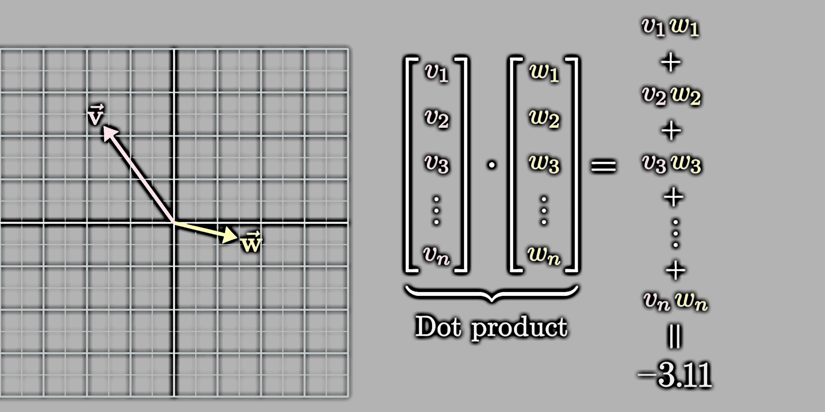

Slide 32
In transformers, vectors don't just represent words.
They also capture:
Position of the word.
Context around the word.

Slide 33
How Does Context Work?
Example: The word "king".
Initial vector = basic meaning of king.
After passing through the transformer layers, it becomes:
A king from Scotland.
Who murdered the previous king.
Described in Shakespearean language.
This happens because transformers allow the vector to absorb meaning from the sentence.

Slide 34
Why is Context Important?
Meaning of words like "quill" changes:
Hedgehog quill (animal).
Quill as a pen (writing tool).
Only context tells the model which one you mean.
At first: Each vector is just a lookup from the embedding matrix.No context, just the basic word.
After layers:
Vectors become contextualized, rich with sentence meaning.

Slide 35
Limitation - Context Size
GPT-3's context size = 2048 tokens.
It can only look at this many words at once.
Older models would "forget" earlier parts in long texts.
Modern models are improving this limitation.

Slide 36
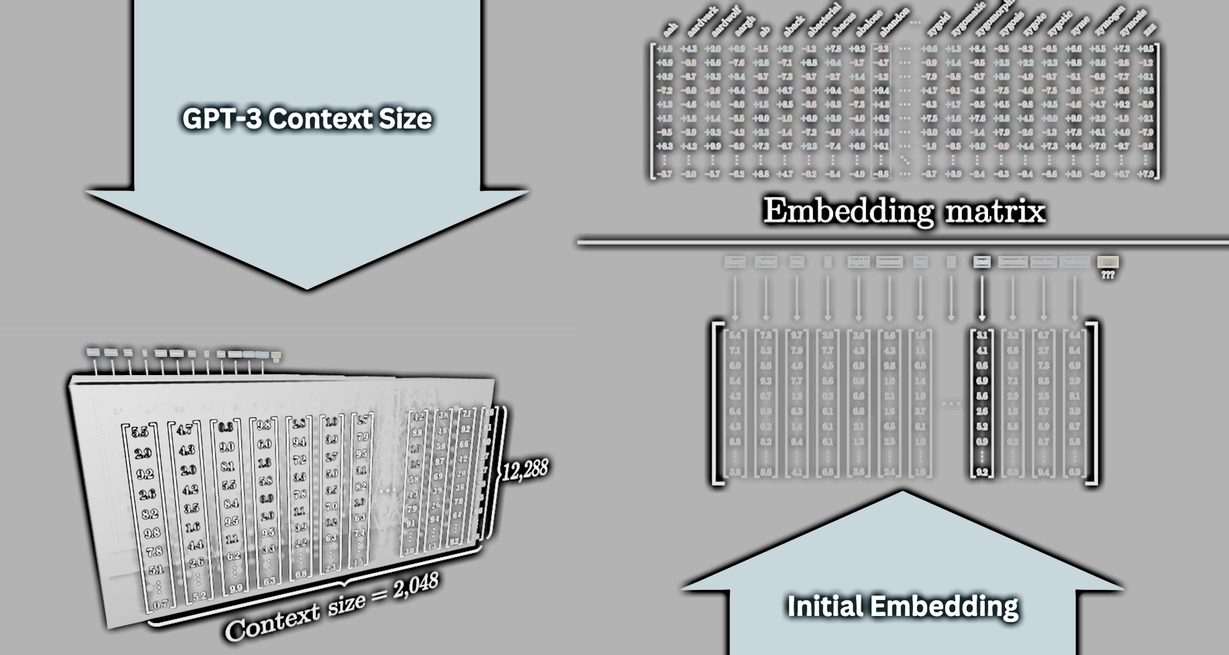

Slide 37
Unembedding
Goal of the Transformer: Predict the next word based on context.
Output: A probability distribution over all possible next words.
Example Scenario: Input context: "Harry Potter's least favorite Professor is ..."
What should the model do?

Slide 38
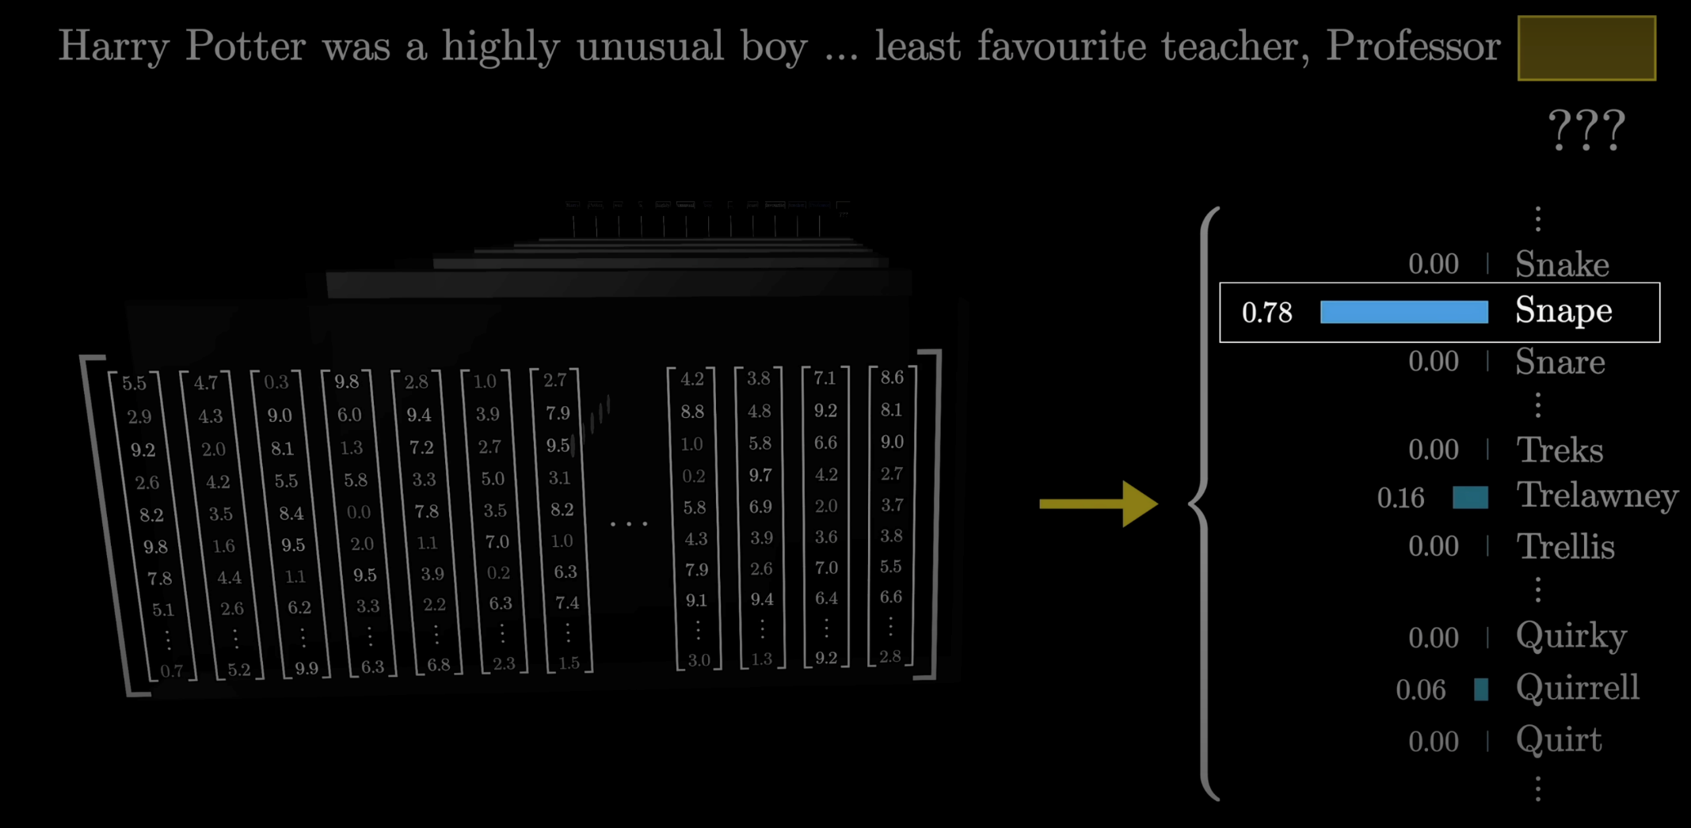

Slide 39
The model will assign probabilities to words like:
Snape → high probability
McGonagall → lower probability
Dumbledore → lower probability
Chair → almost zero probability
Result: The word with the highest probability is selected as the predicted next word.

Slide 40
Unembedding Matrix
Step 1:The last embedding vector goes through another matrix called the Unembedding Matrix (labeled as Wu) which produces ~50,000 values — one for each word/token.
Step 2:These values are converted into a probability distribution using the softmax function.
Question: Why only use the last vector when others are full of context?
Answer: Actually, every vector in the final layer predicts the next word for its position. This makes training more efficient — we get thousands of predictions per input.

Slide 41
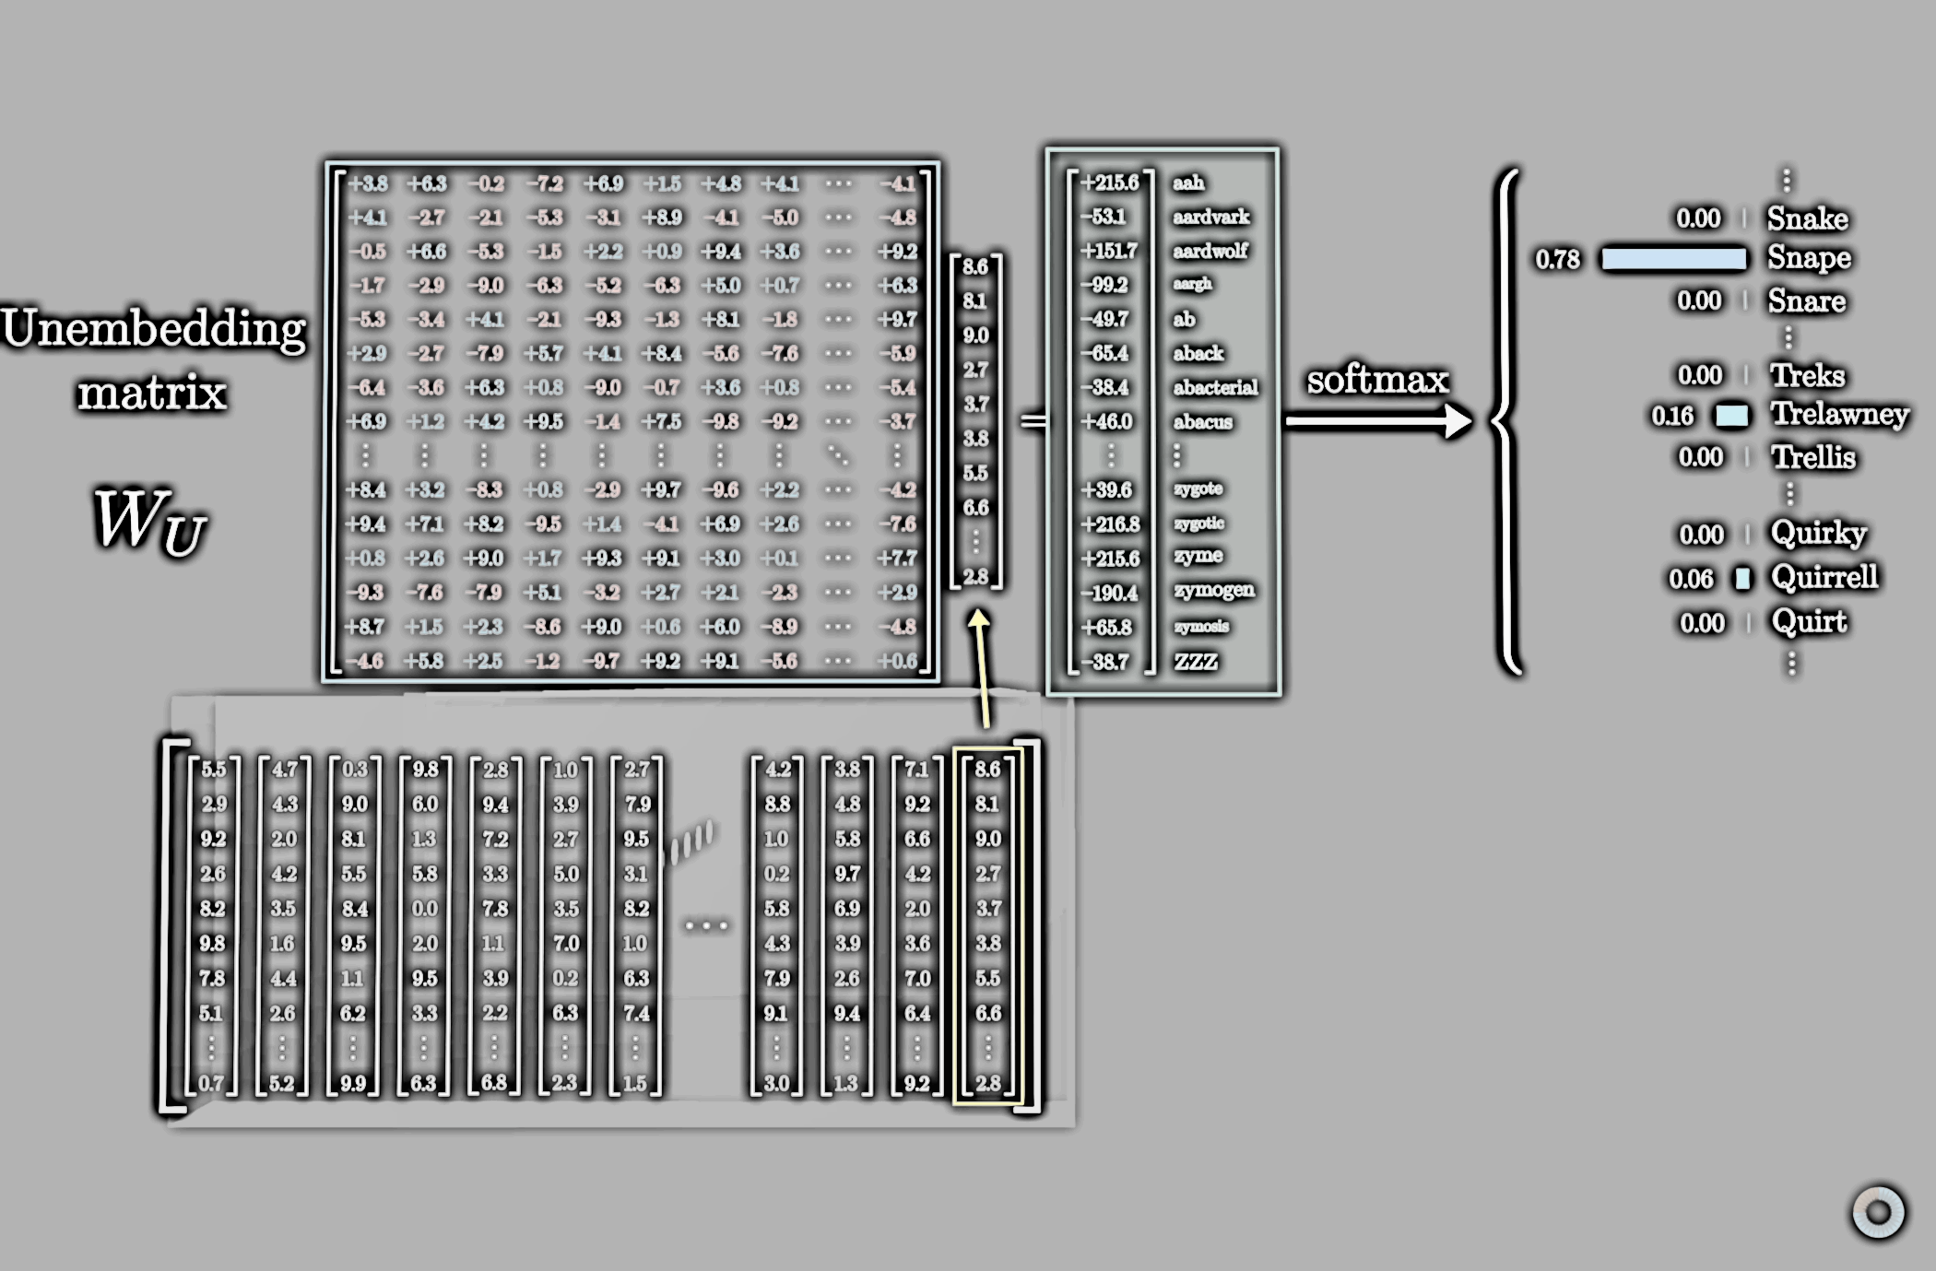

Slide 42
The Unembedding Matrix has:
50,257 rows (one for each word/token)
12,288 columns (matching embedding dimensions)
It is structurally similar to the Embedding Matrix, but rows and columns are swapped.
Total Parameters in Unembedding Matrix: ≈ 617 million
Current Parameter Count: Just over 1 billion parameters so far.
Reminder: The full GPT-3 model has 175 billion parameters, so this is still just a small part!

Slide 43
Softmax
We need the model's output to become a probability distribution (values between 0 and 1, all adding up to exactly 1).
However, the model naturally outputs random real numbers (negative, positive, bigger than 1, etc.).
The Softmax function fixes this:
It transforms any list of numbers into a list where:
Every number is between 0 and 1.
All numbers together sum to 1.
This allows us to interpret the output as:
"Probability of each word/token being the next word."

Slide 44
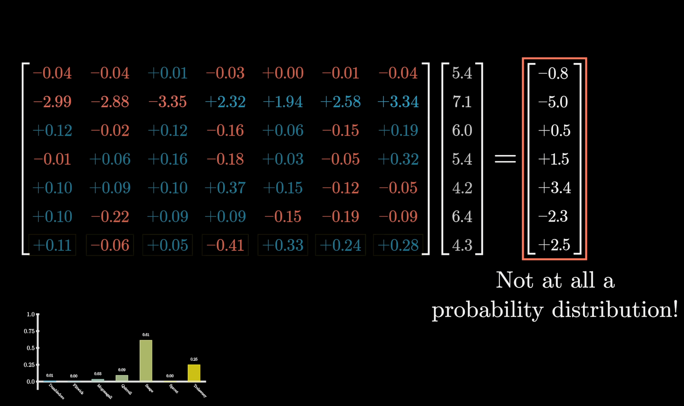

Slide 45
Steps:
Raise e to the power of each number → makes all values positive.
Divide each by the sum of all new values → makes them add up to 1.
Why "Soft" Max?
Instead of just picking the biggest number (like a hard max), it:
Emphasizes the larger numbers.
Softly spreads probability among others depending on how large they are.
If one number is much bigger → it still gets most of the probability.

Slide 46
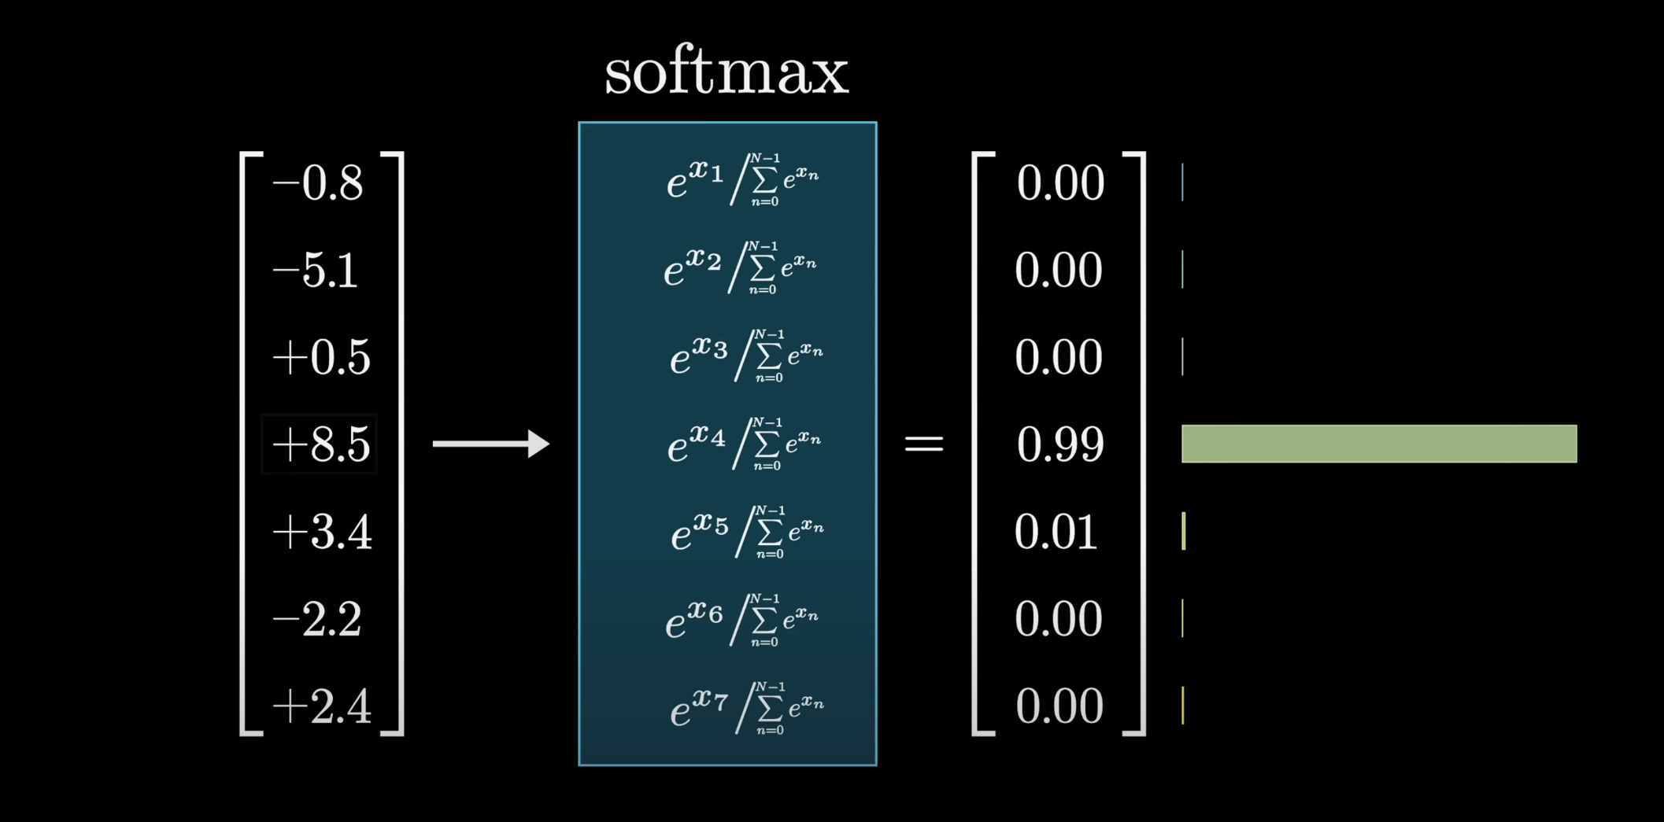

Slide 47

Temperature in Softmax
What is Temperature (T)?
A constant added inside softmax to control the shape of the distribution.
Inspired by thermodynamics → adjusts "smoothness" of probabilities.
Effects of T:
High T (>1) → More uniform distribution (adds randomness).
Low T (<1) → Distribution sharpens, large values dominate.
T = 0 → Acts like a hard max, picks only the largest value.
Use in ChatGPT:
Controls creativity vs. determinism.
Higher T = More diverse, less predictable.
Lower T = More confident, focused predictions.
$$\frac{e^{{x_{i}}/T}}{\sum_{n=0}^{N−1}{}e^{{x_{n}}/T}}$$

Slide 48
